Slide 1
Phillip Waddles
phillip.waddles@ascensus.com

Slide 2
Why you should be saving for college now
$20,090 – average annual cost of tuition, fees, room & board at an in-state public college or university*
$29,562 – the average student debt upon graduation**
59% of students in Indiana leave with debt**
Saving any amount ahead of time creates an expectation of attending and completing post-high school education, and most importantly, can reduce or eliminate the need for costly student loans
* Source: College Board, Trends in College Pricing, 2016.
**The Institute for College Access and Success, State by State Data 2016.

Slide 3
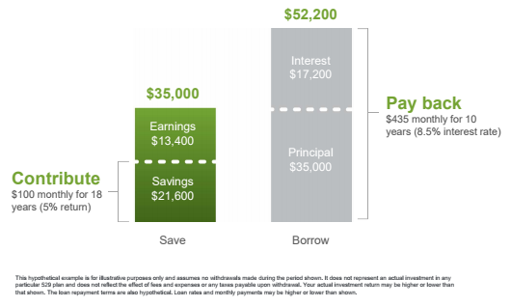
Saving now can help ease post-college debt
Scenario 1: Emma’s parents start investing $100/month into a 529 plan account right after her birth
In 18 years (assuming 5% annual rate of return) they could potentially save more than $35,000*
Scenario 2: Emma (or her parents) borrow $35,000 to pay for college
Based on a private student loan interest rate of 8.5%, they could be faced with monthly payments of $435 for 10 years (or $52,200)
* A plan of regular investment cannot assure a profit or protect against a loss in a declining market.
Notes:
Unfortunately, many parents and families put off saving for higher education and just plan on taking out student loans when the time comes.
As you can see from the two scenarios on this slide, saving now can help you save later. And while you might not be able to save for the entire cost of college, you can significantly reduce the amount you or your student will have to borrow.
In Scenario 1, Terry’s parents started saving $100 each month when he was born. After 18 years and assuming a 5% rate of return on their investments, they could have potentially saved over $35,000.
In Scenario 2, Terry or his parents put off saving and had to borrow the $35,000 they could have already built up to pay for college. Based on a potential private student loan interest rate of 7%, Terry could be faced with a monthly payment of $406 for 10 years, or a total of over $48,000 in debt repayment -- $27,000 more than the money they would have set aside in Scenario 1.

Slide 4
The CollegeChoice 529 Direct Savings Plan: An Overview
Notes:
Fortunately, 529 Plans like the CollegeChoice 529 Direct Savings Plan are specially designed to help you and your loved ones start saving for future education expenses. Let’s learn more about it!

Slide 5
The CollegeChoice 529 Direct Savings Plan
Sponsored by:
State of Indiana
Indiana Education Savings Authority
Chaired by Treasurer of State Kelly Mitchell
In partnership with:
Ascensus
Notes:
The CollegeChoice 529 Direct Savings Plan is sponsored by the State of Indiana and administered by the Indiana Education Savings Authority, which is chaired by State Treasurer Kelly Mitchell. The program is managed with help from Ascensus College Savings, the national leader in 529 assets.

Slide 6
What are the tax benefits?
Tax-deferred growth
Earnings grow tax-deferred until withdrawn
Tax-free withdrawals for qualified higher education expenses*
Use the money for tuition, fees, certain room & board costs, books, computers & required supplies
Any qualifying post-secondary institution, including 2- and 4-year, public or private colleges or universities, vocational/technical schools, and graduate programs
Special tax credit for Indiana taxpayers
Contributions to a CollegeChoice 529 account are eligible for a state income tax credit of 20%, up to $1,000 credit per year**
Contributions must be postmarked by 12/31, or electronically initiated by 11:59 p.m. Eastern Time on 12/31, and in good order?
* Earnings on non-qualified withdrawals are subject to federal income tax and may be subject to a 10% federal penalty tax. Non-qualified withdrawals may also be subject to state and local income tax. The availability of tax or other benefits may be contingent on meeting other requirements.
** This credit may be subject to recapture from the account owner (not the contributor) in certain circumstances, such as a rollover to another state’s 529 plan, a non-qualified withdrawal, or a withdrawal for K-12 tuition expenses at a school outside of Indiana.
Notes:
Most states offer 529 Plans with a number of tax benefits. From a federal tax perspective, all of your earnings will grow tax-deferred and can be withdrawn tax-free when used for a qualified higher education expense. Additionally, Indiana has the best state tax incentive in the nation: a 20% state income tax credit worth up to $1,000 every year. For example – If you were to contribute $5,000 to a CollegeChoice 529 account, you are eligible to claim a $1,000 credit on your state tax return. If you contribute less than $5,000, you are eligible for a 20% credit on whatever contributions were made in that tax year. The tax credit is available to both account owners and third-party gift contributors, so parents, grandparents and others can all work together to save and take advantage.
Most states offer a tax deduction, the total impact of which is more difficult to understand and plan around. Indiana is fortunate to offer a tax credit that can come right off the bottom line of your tax liability.
Additionally – assets saved in a 529 Plan account can be used for tuition and fees, room and board, books, computers and required supplies at most accredited higher education institutions across the country – in fact, at any school that is eligible to receive federal financial aid. These can include traditional two- or four-year universities, both public and private, in-state and out-of-state, graduate programs, and skilled trade or technical schools.

Slide 7
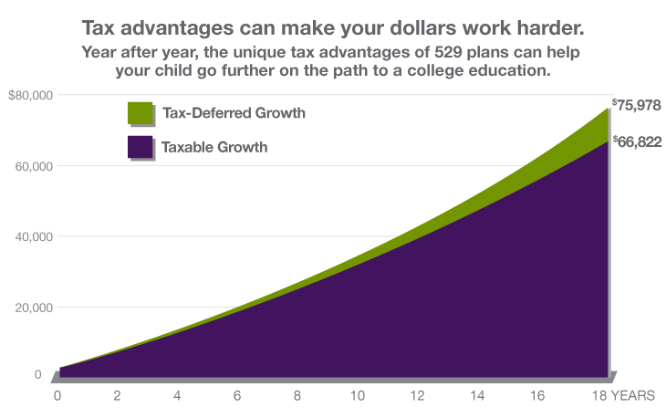
Why are these tax benefits important?
Assumptions: $2,500 initial investment with subsequent monthly investments of $200 for a period of 18 years; annual rate of return on investment of 5% and no funds withdrawn during the time period specified; taxpayer has a 24% Federal income tax rate for all options at the time of contributions and distribution. This hypothetical is for illustrative purposes only. It does not reflect an actual investment in any particular 529 plan or any taxes payable upon distribution. Actual investment returns may be higher or lower than those shown.
Notes:
This slide illustrates the difference between a taxable account and a tax-deferred account, like a 529 Plan. As you can see, regardless of how much you are saving, you will typically end up with more assets in the tax-deferred account, because you are not paying taxes each year on the earnings as you would in a regular, taxed savings account. The longer and more you save, the more your 529 Plan account is able to take advantage of the power of compounding interest.

Slide 8
How affordable and flexible is the Plan?
Low fees
0.18% to 0.82% of invested assets, depending on the investments chosen
$20 annual account fee (waived when account owner or beneficiary is an Indiana resident, or if account balance is $25,000+)
Low contribution amounts
$10 (per paycheck) for contributions made through payroll deduction
$10 minimum for all one-time or ongoing contributions (electronic fund transfer, Automatic Investment Plan* or check)
High maximum contribution limits
$15,000 per contributor per beneficiary annually
$450,000 per beneficiary in all accounts
*A plan of regular investment cannot assure a profit or protect against a loss in a declining market.
Notes:
CollegeChoice 529 strives to keep fees in the Direct Plan affordable. Currently, fees range from 20 to 84 basis points, or between $2.00 and $8.40 per $1,000 in the account. These will vary based on the portfolio or portfolios you are invested in, and fees have been reduced by over 10% for most accounts in the past two years. Indiana residents, whether they are the account owner or its beneficiary, do not pay an annual account fee.
The low minimum contribution amount of $10 ensures that almost anyone who wishes to save may do so. Any additional one-time or recurring contribution must also be at least $10. Aside from that, there are no requirements as to how much or how often you must contribute.
There are also high maximum limits for those who wish to save a substantial amount. Each year, a contributor may save up to $14,000 per beneficiary. Altogether, all contributors may save or earn up to $450,000 per beneficiary in all accounts under the beneficiary’s name.

Slide 9
What are the investment options?
Year of Enrollment Portfolios – professionally managed by Vanguard
One of the world’s largest investment firms
Over $1 trillion in assets under management
Commitment to high-value, low-cost investing
Individual Portfolios
Wide range of investments from respected firms
Notes:
We have a variety of investment options for you to choose from within the CollegeChoice Direct Plan. The first is our Age-Based option, which is based on the age of the account beneficiary and is managed mostly by Vanguard, a household name in the investment world. We also offer a number of individual options that give you the flexibility to choose which you would like your contributions to be invested in, based upon need or preference.

Slide 10
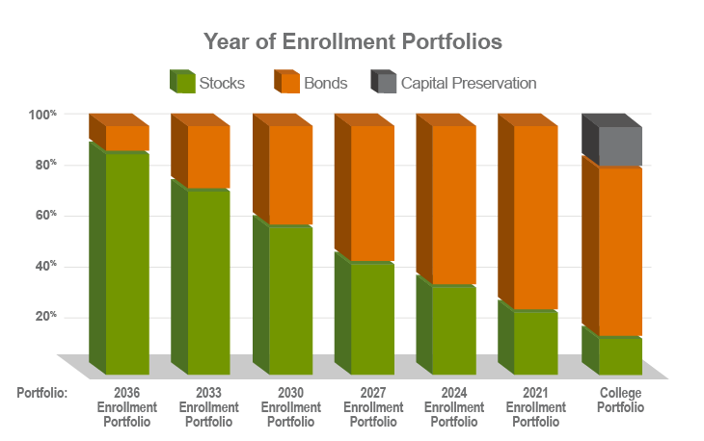
Year of Enrollment Portfolios
Automatically become more conservative as the beneficiary approaches higher ed enrollment
You could lose money by investing in a portfolio which includes the Vanguard Short-Term Reserves Account which in turn invests in the Vanguard Federal Money Market Fund as well as Funding Agreements and Synthetic Investment Contracts (SICs). Although the money market fund in which your investment option invests (the “underlying fund”) seeks to preserve its value at $1.00 per share, the underlying fund cannot guarantee it will do so. An investment in this investment option is not insured or guaranteed by the Federal Deposit Insurance Corporation or any other government agency. The underlying fund’s sponsor has no legal obligation to provide financial support to the underlying fund, and you should not expect that the sponsor will provide financial support to the underlying fund at any time.
The Year of Enrollment Portfolios’ investment in the Stable Value Fund is not insured or guaranteed by the Federal Deposit Insurance Corporation or any other government agency.
Notes:
The Age-Based portfolios are our most popular investment option and are ideal for the “Set it and forget it” investor. These portfolios automatically invest your assets based on the age of your account beneficiary. The portfolios automatically grow more conservative as the beneficiary nears college age.
For instance, a baby with a CollegeChoice 529 account could be invested in the Aggressive Growth Portfolio, designed to maximize returns from stocks early on. A high school student’s account could be invested more conservatively in the Income or Conservative Income Portfolios, enabling his or her family to plan for upcoming higher education expenses based on a more stable account value.

Slide 11
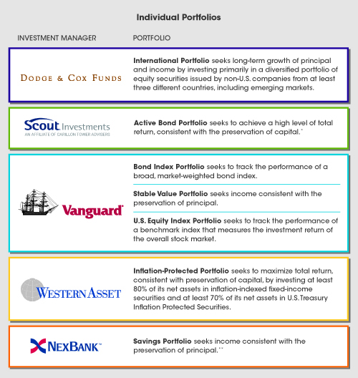
Individual Portfolios
* As a result of investing in undervalued sectors of the market as well as in non-investment grade securities, the Portfolio may at times experience periods of high volatility, especially when the market itself is experiencing dramatic volatility.
** The Savings Portfolio invests 100% of its assets in the NexBank High-Yield Savings Account (“HYSA”). The HYSA is held in an omnibus savings account insured by FDIC, which is held in trust by the Indiana Education Savings Authority at NexBank. Contributions to and earnings on the investments in the Savings Portfolio are insured by the FDIC on a pass-through basis to each account owner up to the maximum amount set by federal law – currently $250,000. The amount of FDIC insurance provided to an account owner is based on the total of: (a) the value of an account owner’s investment in the Savings Portfolio; and (b) the value of all other accounts held by the account owner at NexBank, as determined by NexBank and FDIC regulations.
Notes:
For those that enjoy more flexibility and variety, we also offer a number of individual options. These range from an International Portfolio, to multiple Bond funds, to an FDIC-insured Savings Portfolio offered by Sallie Mae Bank.

Slide 12
Account owners:
Beneficiaries:
Can be any U.S. citizen or resident alien*
Are usually a parent, grandparent, other family member or friend
Are not subject to income eligibility requirements
Can own multiple accounts
Can be any U.S. citizen or resident alien**
Are usually a child or grandchild, but can be anyone, including yourself or spouse
Are not subject to income eligibility requirements
Can be the beneficiary of multiple accounts
* The account owner retains control of how and when the money is used *
* Must be 18 or older, have a Social Security number or Tax Identification number, and a U.S. address that is not a P.O. Box.
** Must have a Social Security number or Tax Identification number, and a U.S. address that is not a P.O. Box.
Notes:
Any U.S. Citizen or resident alien can be an account owner. Typically an account owner is a parent or grandparent, but anyone can save. There are no income limitations for participants and an account owner can own multiple accounts for multiple beneficiaries, as each account has one beneficiary. One benefit of a 529 Plan is the account owner always retains control of the assets. Therefore, only the account owner can make withdrawals, working with the beneficiary to ensure they are used for qualifying expenses.

Slide 13
What if the beneficiary doesn’t go to college?
Leave the money in the account until a later date
Change the beneficiary to a “member of the family”
Make a non-qualified withdrawal, subject to federal/state income tax & 10% federal penalty on the earnings portion only, and potential tax credit recapture
Several categories of withdrawals are exempt from the 10% penalty tax and tax credit recapture, namely a beneficiary’s:
Receipt of a scholarship
Attendance at a military academy
Disability or Death
Notes:
Frequently we are asked “what if my child doesn’t go to college?” In this case, you have a few options. First, you can leave the account open until a later date. There is no expiration date on the account and perhaps the beneficiary may decide a year or so down the road they would like to attend college after all. Otherwise – you may change the beneficiary on the account to a family member of the original beneficiary. Family member is broadly defined by the IRS, leaving you with plenty of options to use your CollegeChoice savings for their intended purpose. Finally, if absolutely no one in your family can use the funds for qualified education expenses, you can withdraw the funds. If you withdraw them for an unqualified expense, you’ll pay state and federal income taxes and a 10% penalty on the earnings portion of the account only. In some circumstances, you could also face recapture of the state income tax credit. However, the principal portion, or money you contributed directly to the account, would not be taxed, meaning you would not lose your money.

Slide 14
How can you enroll?
It’s easy to enroll online in about 10 minutes
You will need:
The account owner’s Social Security Number, date of birth, permanent address, email address
The beneficiary’s Social Security Number, date of birth, state of residence
Select your investment option(s): Year of Enrollment or Individual Portfolio(s)
Make your initial investment
$10 with direct deposit*
$10 with an Automatic Investment Plan*
$10 with a check or electronic fund transfer
Rollover from another 529 program
*A plan of regular investment cannot assure a profit or protect against a loss in a declining market.
Notes:
Enrolling online in the CollegeChoice 529 Direct Savings Plan is very easy and takes just 10 minutes and 10 dollars. You will need the account owner and beneficiary’s personal contact and identification information. Your initial deposit of $10 may be made via check or an electronic funds transfer. You may also set up a recurring investment plan in future increments of at least $10.

Slide 15
About Direct Deposit
Notes:
The CollegeChoice Plans make it easy for employees of the State of Indiana to save for education via direct deposit from their paycheck.

Slide 16
How does direct deposit work?
You can sign up for direct deposit during or after enrollment by:
Enrolling in the Plan either online or with a paper application form;
Generating a PDF Direct Deposit Authorization Form and mailing it to CollegeChoice 529.
Contribute as little as $10 per account, per pay period (Direct Plan)
Contributions to your 529 account are made from each paycheck after taxes
You can start, stop, or change your direct deposit at any time by updating your direct deposit instructions online and mailing a new form to the Plan
Notes:
To take advantage of this benefit, state employees must complete the regular enrollment process by registering online or with a paper enrollment kit. During the online enrollment process, one step will ask how the employee wants to fund his or her account. He or she may choose direct deposit and print a pdf payroll authorization form. The employee must print it out, sign and date it and fax or mail it to the Plan at the address provided. These instructions also appear on the form.
To participate, employees are required to contribute at least $10 per account after taxes per pay period, but can start, stop or change their contribution amounts at any time by logging in to their account and generating a new form.

Slide 17
Additional Savings through Ugift® and Upromise®
Notes:
CollegeChoice 529 account owners may also take advantage of a few additional free programs to enhance their savings experience.

Slide 18
Ugift® – Give the Gift of College Savings
Easy-to-use online gifting program
Invite family and friends to celebrate a beneficiary by gifting college savings alongside or in place of a traditional present
Great for:
Birthdays
Religious celebrations
Graduations
Holidays
Any other occasion!
Third-party gift contributors who are Indiana taxpayers are also eligible for the 20% state income tax credit of up to $1000 each year
Notes:
Ugift is an online gifting program offered through the CollegeChoice Direct Plan. Ugift allows you to invite family and friends to celebrate birthdays, holidays, graduations and other milestones by making contributions to a CollegeChoice 529 account.

Slide 19
How does Ugift® work?
ANYTIME
Get a Ugift code for each beneficiary’s CollegeChoice 529 account
Share the code with family & friends
Those family & friends make a gift contribution directly into the beneficiary’s account at any time at Ugift529.com
Gift givers can set up profiles to store their beneficiary details and banking information, and can even set up recurring gifts!
It’s that easy!
Notes:
Participants in the Direct Plan can log in to their account at any time and get a customized Ugift code for each beneficiary. This code can be entered by gift contributors at ugift529.com whenever they wish to make a contribution to their loved one’s CollegeChoice 529 account.
Participants may also send customized email or print invitations to family and friends. These contain special coupons that can be returned with a check.
No matter which method you use, Ugift is a great way to supplement your college savings and invite relatives and friends to give the gift of education.

Slide 20
Earn extra college savings with Upromise®
Join Upromise for free at www.upromise.com
Link your Upromise account to your CollegeChoice 529 account on the secure Upromise website
Get cash back for college when you eat out at a restaurant, shop online, buy groceries, fill the gas tank, book travel, and more
Upromise earnings are automatically transferred to your linked CollegeChoice 529 account on a periodic basis (subject to a $25 minimum)
Hundreds of leading companies can help you save for college!
* Upromise is an optional service offered by Upromise, Inc. that is separate from the CollegeChoice 529 Direct Savings Plan, and is not affiliated with the State of Indiana. Specific terms and conditions apply. Participating companies, contribution levels, and terms and conditions are subject to change without notice. Transfers from Upromise to a CollegeChoice 529 Direct Savings Plan account are not eligible for the Indiana state income tax credit.
Notes:
Another free program we offer is Upromise Rewards. To join, visit www.upromise.com/indiana and link your CollegeChoice 529 account with your Upromise account. You can earn cash back on everyday purchases, which can then be automatically transferred to your CollegeChoice account in increments of at least $25.

Slide 21
How do I learn more?
Visit www.collegechoicedirect.com
Learn more about the Plan and investment options
Enroll online or request an enrollment kit
Call 1.866.485.9415 to speak with a CollegeChoice 529 Client Service Representative
Monday through Friday, 8 a.m. to 8 p.m. ET
Learn More about CollegeChoice CD at www.collegechoicecd.com
Contact a Service Representative at: 1.888.913.2885
Monday through Friday, 9 a.m. to 6 p.m. ET
Notes:
To learn more or enroll in the CollegeChoice 529 Direct Savings Plan, please visit www.indianas529.com. If you already have an account or have questions about your account after enrollment, you may speak with a Client Service Representative by calling 1.866.485.9383.

Slide 22
Questions and Answers

Slide 23
Important legal information
For more information about the CollegeChoice 529 Direct Savings Plan (“CollegeChoice 529”), call 1.866.485.9415 or visit www.collegechoicedirect.com to obtain a Disclosure Statement, which includes investment objectives, risks, charges, expenses, and other important information; read and consider it carefully before investing.
Before you invest, consider whether your or the beneficiary’s home state offers any state tax or other state benefits such as financial aid, scholarship funds, and protection from creditors that are only available for investments in that state’s qualified tuition program.
CollegeChoice 529 is administered by the Indiana Education Savings Authority (Authority). ABD , the Program Manager, and its affiliates, have overall responsibility for the day-to-day operations, including investment advisory, recordkeeping and administrative services, and marketing. CollegeChoice 529’s Portfolios invest in: (i) mutual funds; (ii) a stable value account held in trust by the Authority at Vanguard; and/or (iii) an FDIC-insured omnibus savings account held in trust by the Authority at NexBank.
Investment returns will vary depending upon the performance of the Portfolios you choose. Except to the extent of FDIC insurance available for the Savings Portfolio, depending on market conditions, you could lose all or a portion of your money by investing in CollegeChoice 529. Account Owners assume all investment risks as well as responsibility for any federal and state tax consequences.
Not FDIC-Insured (except for the Savings Portfolio). No Bank, State or Federal Guarantee. May Lose Value.
© 2018 Indiana Education Savings Authority and Ascensus Broker Dealer Services, LLC

